Slide 1
A Trip To The Antique Wireless Association
Many thanks to Arvela and Steve Heider (W0LUB & XYL) for sharing their recent trip to the National Antique Wireless Museum.

Slide 2
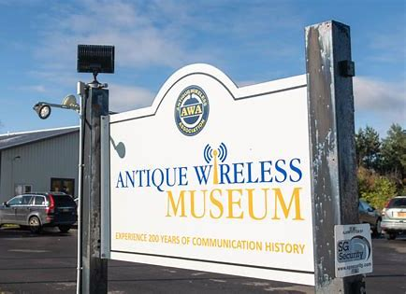
Notes:
Last Fall the Heiders went to the new and greatly expanded AWA Museum in Bloomfield, NY.

Slide 3
Notes:
We had a very nice and knowledgeable tour guide.

Slide 4
Notes:
They have a quite a few QSL cards on display.

Slide 5
Notes:
The middle object is an old ‘straight’ key. In the old days, there were no codeless licenses. Need to learn how to send and receive code.

Slide 6
Notes:
The top shelf has an unidentified headphones. To the right of the headphones is a T-17 carbon microphone.
The bottom shelf (perhaps a table) is a BC-375 transmitter. These were available on surplus after WWII at prices teenagers could afford. The plug in tuning unit in the bottom that is not well shown but I remember that it was was very difficult to set the frequency. I had a friend who used a BC375 when he was in the army. He said that the VFO calibration could not be trusted!

Slide 7
Notes:
This is a collection of communications receivers that were great fun to look at.

Slide 8
Notes:
This Halicrafters may be the receiver that covers some low frequency through the high frequency ranges up about 30 MHz..
Just below is a S-38 which does not have any meters. My brother, bought original S-38 in the summer of 1947 when the Heider family moved to Kansas.

Slide 9
Notes:
On the bottom is probably a Collins 32V2 or 32V3. These were about 100 Watt input transmitters. Beside the transmitter is probably a 75A-4 receiver.

Slide 10
Notes:
This is a Hammerlund HQ-129X. Bob Schober has one of these in his collection. These were very popular in the early 1950’s. This receiver switch has six bands and will work better than receivers with only a four position band switch such an National NC 183D owned by SMH

Slide 11
Notes:
This picture is about is variety of communications equipment some of which are home made or custom made.

Slide 12
Notes:
This is probably an HRO receiver with a collection of plug-in coils to the left of the HRO.
National had nice advertisement in QST that continued after the equipment was obsolete.(They wanted to support the AARL.

Slide 13
Notes:
In WW1 and WW2, hams lost their operating privileges but they they were later restored. I not know the exact dates of these events, but the Ban Off picture is the celebration of one of these events.

Slide 14
Notes:
Here is a good example of an early receiver of unknown design with loop antenna.
A loop antenna properly used could be very useful for avoiding interference.

